Slide 1
Can LLM attention enable efficient KV caching with frugal memory without hurting long-context reasoning?
CSCI 601-771 (NLP: Self-Supervised Models)
Ernie Chu, Jonathan Lee
https://self-supervised.cs.jhu.edu/fa2025/

Slide 2

KV-Cache Eviction Dimension
Dropping irrelevant tokens. But how to determine the relevancy?
Old tokens
New
K/V Cached
[Figure credit: Arman Cohan]

Slide 3
KV-Cache Eviction Dimension
Eviction in other dimensions?
Evict non-adjacent tokens?
Head / Layer dimensions
K/V Cached
[Figure credit: Arman Cohan]

Slide 4
KV-Cache Eviction
Only transfer essential caches
Eviction
Cheap CPU memory / disk
Costly GPU memory

Slide 5
Analogy to Software Engineering
Static
Code analysis
Dynamic
Runtime state analysis
Redesigned
Rewriting the code
Notes:
3 major types
First, borrow terms from SE

Slide 6
KV-Cache Eviction Types
Static - prefill stage
Evict KV cache based on the initial prompts (contexts)
Pros: minimal latency in runtime
Cons: cannot handle future tokens (generation, follow-up questions)
Dynamic - decode stage
Evict KV cache based on runtime tokens
Pros: preserve all info
Cons: runtime analysis overhead
Redesigned - train stage
Restricting attending position by finetuning (e.g., use local attn in training)
Pros: no discrepancy between training/inference
Cons: cannot generalize to different tasks and models (need FT)
Notes:
Follow the flow, don’t repeat

Slide 7
KV-Cache Eviction Types
Static - prefill stage
Evict KV cache based on the initial prompts (contexts)
Pros: minimal latency in runtime
Cons: cannot handle future tokens (generation, follow-up questions)
Dynamic - decode stage
Evict KV cache based on runtime tokens
Pros: preserve all info
Cons: runtime analysis overhead
Redesigned - train stage
Restricting attending position by finetuning (e.g., use local attn in training)
Pros: no discrepancy between training/inference
Cons: cannot generalize to different tasks and models (need FT)

Slide 8
KV-Cache Eviction Types
Static - prefill stage
Evict KV cache based on the initial prompts (contexts)
Pros: minimal latency in runtime
Cons: cannot handle future tokens (generation, follow-up questions)
Dynamic - decode stage
Evict KV cache based on runtime tokens
Pros: preserve all info
Cons: runtime analysis overhead
Redesigned - train stage
Restricting attending position by finetuning (e.g., use local attn in training)
Pros: no discrepancy between training/inference
Cons: cannot generalize to different tasks and models (need FT)

Slide 9
KV-Cache Eviction Types
Static - prefill stage
Evict KV cache based on the initial prompts (contexts)
Pros: minimal latency in runtime
Cons: cannot handle future tokens (generation, follow-up questions)
Dynamic - decode stage
Evict KV cache based on runtime tokens
Pros: preserve all info
Cons: runtime analysis overhead
Redesigned - train stage
Restricting attending position by finetuning (e.g., use local attn in training)
Pros: no discrepancy between training/inference
Cons: cannot generalize to different tasks and models (need FT)

Slide 10
Static Token Eviction
Determine evicted tokens in prefill stage
Local (with sink)
Strided (new toks have higher resolutions)
Base on attention score -> H₂O, PyramidKV, KVzip
[Figure credit: Zhang et al. H2O]

Slide 11

In this seminar
Static - prefill stage
Previous works
Dynamic - decode stage
The first paper: OmniKV
Redesigned - train stage
The second paper: DuoAttention

Slide 12
OmniKV: Dynamic Context Selection for Efficient Long-Context LLMs
(Jitai Hao, Yuke Zhu, Tian Wang, Jun Yu, Xin Xin, Bo Zheng, Zhaochun Ren, Sheng Guo. ICLR 2025)

Slide 13

Limitations of Static Eviction
The set of important tokens varies depending on the reasoning step
Greens: <$α$> attends to
Blues: <$β$> attends to
Prefill stage
Decode stage
Notes:
Green texts are the alpha token attends to
Blue texts are the beta token attends to
Different runtime tokens look at different places. how can we determine important cache at prefill stage

Slide 14
Limitations of Static Eviction
Given an important token subset from static eviction like H₂O
For each generated token, check if the top tokens it attends to are missing
Different tokens attend to different positions

Slide 15
Limitations of Static Eviction
Static attention scores cannot indicate the future importance of tokens in subsequent generation iterations
Tokens that have low attention scores in the prefill stage may be recalled as important tokens in subsequent reasoning steps.

Slide 16
OmniKV: Retaining all KV Cache
OmniKV retains all KV cache to ensure that performance remains unaffected, while dynamically selecting a sparse subset of tokens for attention computation in the decode stage
Spoiler

Slide 17
Determine Eviction per Layer
Given a full attention transformer

Slide 18
Determine Eviction per Layer
Given a full attention transformer

Slide 19
Determine Eviction per Layer
Given a full attention transformer, assume adjacent layers have similar attn-score
Eviction
Algorithm
Notes:
If we compute a full attn, we can use that to determine an importance score and take only a subset of cache in the next layer
All we have to do is assume adjacent layers have similar attn-score
So we can do the full-attn and sparse attn interlevedly

Slide 20
Determine Eviction per Layer
nearby
Given a full attention transformer, assume adjacent layers have similar attn-score
Eviction
Algorithm
Figure 1
Notes:
To push it further, the author ran tests and observed that the similarity can span across up to 16 layers

Slide 21
Determine Eviction per Layer
nearby
Given a full attention transformer, assume adjacent layers have similar attn-score
Eviction
Algorithm
Figure 1
Notes:
Instead of reusing it once, we reuse the attn-score multiple times.

Slide 22
Determine Eviction per Layer
nearby
Given a full attention transformer, assume adjacent layers have similar attn-score
Figure 1
Notes:
For the first few layers where similarities are low, we run full-attn as usual
purple layers are called filter layers
Green layers reuse the sim from the previous filter layers
Obs window is the tokens that served as query to calculate attn-score
In practice, there will be only around 3 filters layers in a transformer that has 60 plus layers in total

Slide 23
Eviction Algorithm Details
Obs Window: the most recent tokens (~16 toks)
Aggregation methods:
Uniform (avg)
Exponential (emphasize on new toks)
Last Token (window_size = 1)

Slide 24
Eviction Algorithm Details
Figure 3

Slide 25
Eviction Algorithm Details
Last Token is the most robust across various benchmarks
Fast, easy to implement
Table 1

Slide 26
Latency
Figure 4
Notes:
For decoding, we can extend the context length given the same amount of gpu memoy
If we don’t offload the cache to cpu, omnikv is faster than full cache as expected
For prefill, it doesn’t do anything since it’s a dynamic method.

Slide 27
Latency & Performance Tradeoff
Figure 5
Table 2
6400 toks = 30% of full attn
Notes:
On the Rightest column of the figure, 64 hundred is not equal full attn
it’s only 30%
1% drop in performance

Slide 28
Specialized Dataset for Runtime Deps
Existing datasets may not require runtime dependency
Models can “guess” the important tokens using prior knowledge/common sense
2StageRetr(ieve)
Similar to NIAH, but the key is computed in the runtime

Slide 29
2StageRetr Results
Figure 3
Table 6

Slide 30
Choices of Full-Attn Layers (Filter Layers)
Llama3-8B
{2, 8, 18}
Llama3.1-70B
{4, 19, 41}

Slide 31
Takeaways
Leverage redundancy in per-layer attention scores to identify the most informative subset of the KV cache.
by exploiting Inter-Layer Attention Similarity, allowing selected "filter" layers to identify a shared, sparse index of crucial tokens that is propagated to non-filter layers, enabling efficient KV cache retrieval and acceleration during decoding.

Slide 32
Takeaways
Leverage redundancy in per-layer attention scores to identify the most informative subset of the KV cache.
by exploiting Inter-Layer Attention Similarity, allowing selected "filter" layers to identify a shared, sparse index of crucial tokens that is propagated to non-filter layers, enabling efficient KV cache retrieval and acceleration during decoding.
My comments:
An in-depth analysis on finding the optimal filter layers would be nice
Lossy compression theory (rate-distortion)
Analogy to video compression (I-frame = filter layers, what about P, B?)

Slide 33
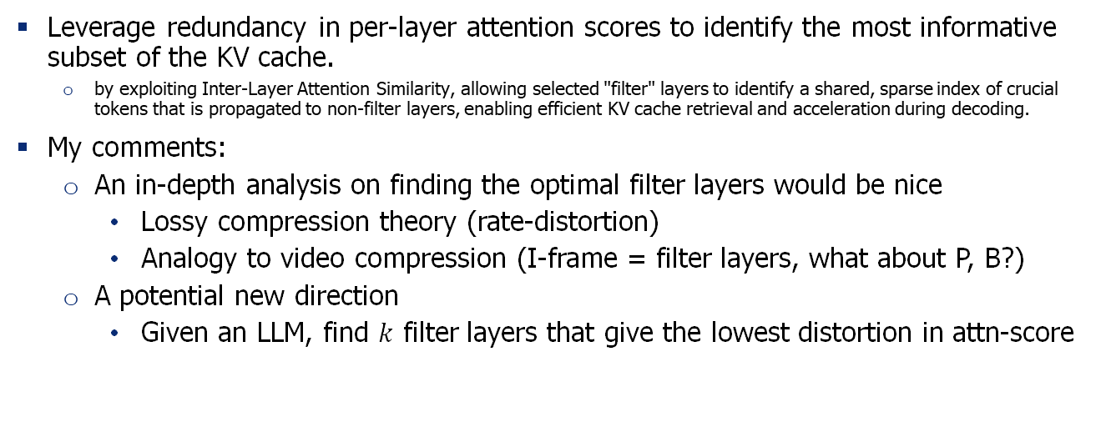
Takeaways
Leverage redundancy in per-layer attention scores to identify the most informative subset of the KV cache.
by exploiting Inter-Layer Attention Similarity, allowing selected "filter" layers to identify a shared, sparse index of crucial tokens that is propagated to non-filter layers, enabling efficient KV cache retrieval and acceleration during decoding.
My comments:
An in-depth analysis on finding the optimal filter layers would be nice
Lossy compression theory (rate-distortion)
Analogy to video compression (I-frame = filter layers, what about P, B?)
A potential new direction
Given an LLM, find $k$ filter layers that give the lowest distortion in attn-score

Slide 34
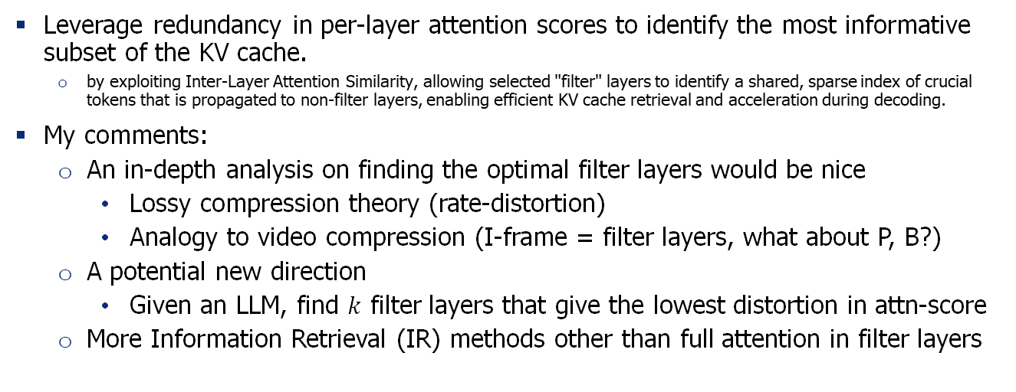
Takeaways
Leverage redundancy in per-layer attention scores to identify the most informative subset of the KV cache.
by exploiting Inter-Layer Attention Similarity, allowing selected "filter" layers to identify a shared, sparse index of crucial tokens that is propagated to non-filter layers, enabling efficient KV cache retrieval and acceleration during decoding.
My comments:
An in-depth analysis on finding the optimal filter layers would be nice
Lossy compression theory (rate-distortion)
Analogy to video compression (I-frame = filter layers, what about P, B?)
A potential new direction
Given an LLM, find $k$ filter layers that give the lowest distortion in attn-score
More Information Retrieval (IR) methods other than full attention in filter layers

Slide 35
In this seminar
Static - prefill stage
Previous works
Dynamic - decode stage
The first paper: OmniKV
Redesigned - train stage
The second paper: DuoAttention

Slide 36
DuoAttention: Efficient Long-Context LLM Inference with Retrieval and Streaming Heads
(Guangxuan Xiao, Jiaming Tang, Jingwei Zuo, Junxian Guo, Shang Yang, Haotian Tang, Yao Fu, Song Han. ICLR 2025)

Slide 37
Motivation – Long Context LLMs
Long-context inference in LLM is challenging because the KV cache of all previous tokens grows linearly with context length and the attention mechanism’s cost grows quadratically
For the Llama‑3‑8B model, storing FP16 KV-cache for ~1 million tokens would require ~137 GB of memory – beyond a single 80GB GPU.
Key insight: not all attention heads are equally important for long-context dependency; some heads (retrieval) attend globally and need full KV cache, others (streaming) mostly focus on recent tokens or sinks and can use a light cache.

Slide 38
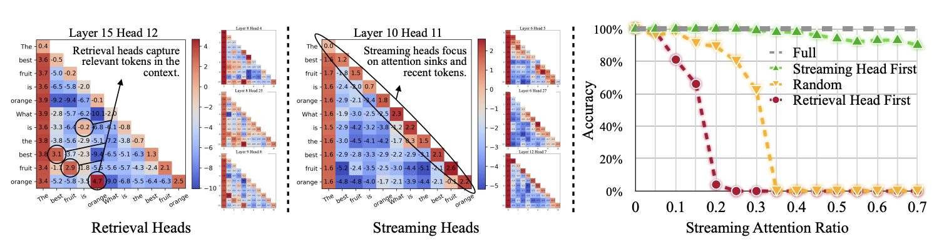
Key Observation
Retrieval Heads
Small fraction of heads
Require full attention across all tokens
Crucial for long context retrieval
Significantly alter model outputs when restricted to recent tokens and attention sinks.
Stream Heads
Majority of heads
Recent tokens and sinks
Sentence: "The best fruit is orange. What is the best fruit? Orange."
Notes:
On the left, retrieval heads capture contextually relevant tokens such as "best," "fruit," and "orange," which are crucial for processing long-context information and,
therefore, require a full KV cache. In the middle, streaming heads primarily focus on initial and recent tokens without emphasizing past contextual relevance. On
the right, the impact of limiting attention to the sink and recent tokens on long-context passkey retrieval accuracy is shown: modifying retrieval heads severely
damages performance, while constraining streaming heads has minimal impacts.
Impact of token prunning

Slide 39
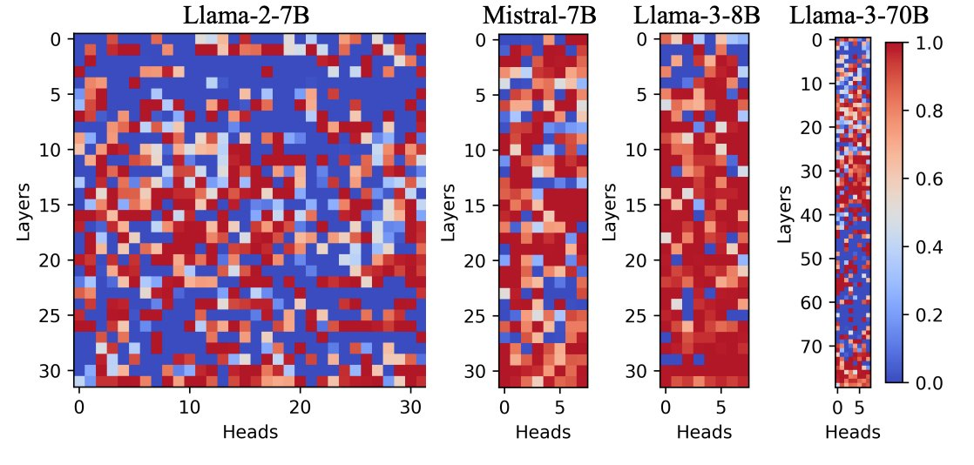
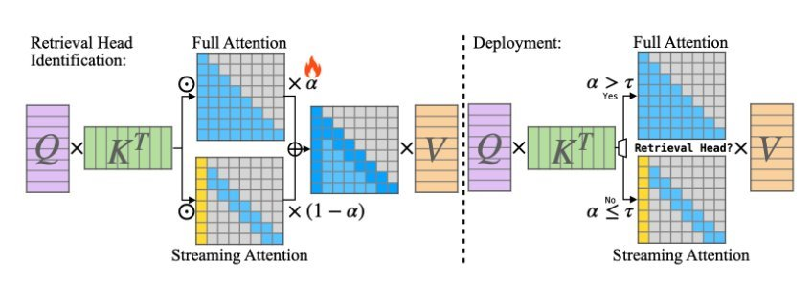
Motivation to Big Picture
Training phase:
Freeze the model and learn one scalar gate α per attention head
These gates represent how much each head depends on long-range context.
Deployment/ Inference:
Heads with α > τ → Retrieval heads (keep full KV cache).
Heads with α ≤ τ → Streaming heads (keep only recent + sink tokens).
Red = Retrieval-heavy heads, Blue = Local heads.
Notes:
instead of pruning by tokens or layers, DuoAttention learns which heads actually need memory and only gives those full context.

Slide 40
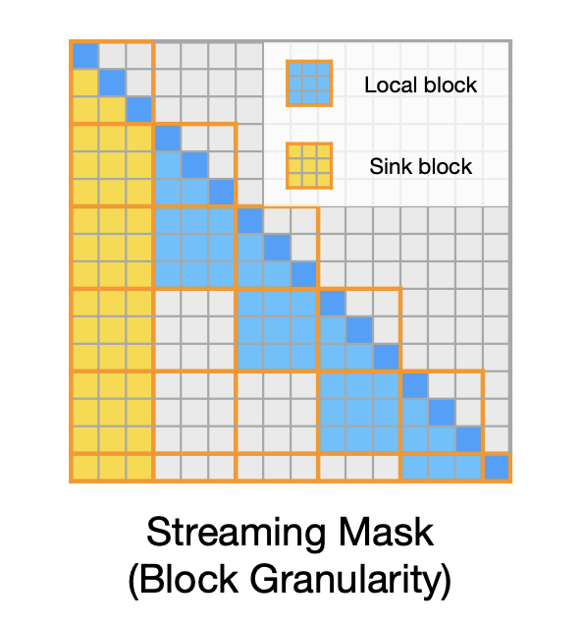
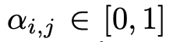
How the Model Learns Head Importance (α-Gates)
Optimization-based head gating using passkey retrieval dataset.
Step 1. Start with all α = 1 (every head treated equally).
Step 2. During training, blend full and truncated attention for each head:
α ↑ ⇒ relies on full attention; α ↓ ⇒ prefers local attention.
Step 3. Adjust α so that the model with truncated cache can imitate the full-cache output.
Notes:
relying solely on natural language modeling objectives is insufficient for identifying retrieval heads because the supervision signal in natural text that requires inference over long spans is sparse, and most tokens can be inferred using local context
Where Mcausal is the causal attention mask (a lower triangularmatrix), and Mstreaming represents a Λ-like mask

Slide 41
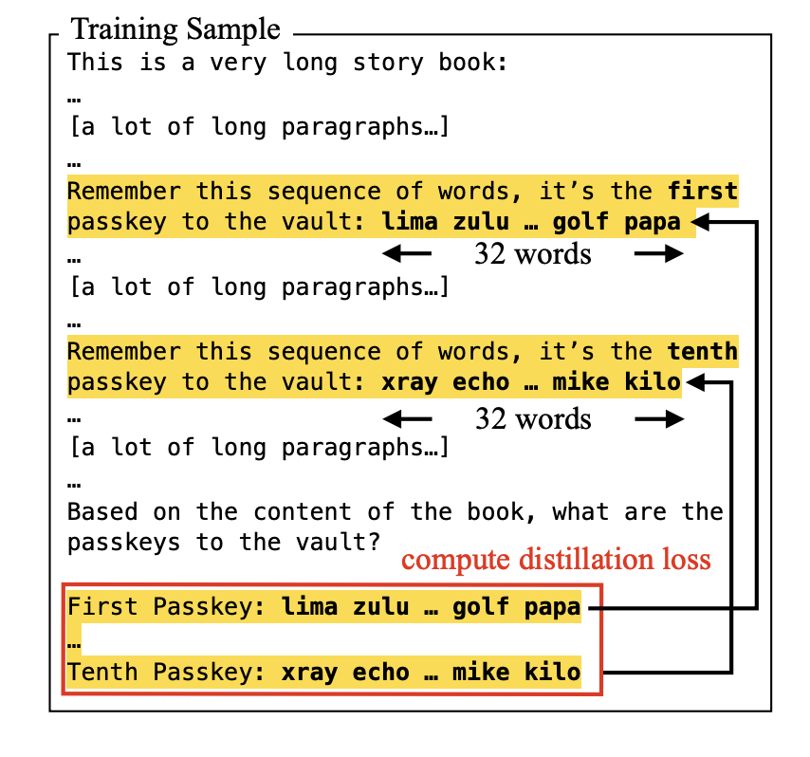
Synthetic Passkey Dataset
Generate long sequences (hundreds K – millions of tokens).
Insert hidden “passkey” strings at random deep positions.
Ask the model to output the passkeys at the end.
Training signal: heads that recover the key get higher α → retrieval heads.
The distillation loss compares teacher (full cache) and student (truncated cache + α) predictions on this task.
Notes:
Using this dataset to effectively identify which KV heads can be compressed without compromising the model’s performance
isolates long-range retrieval ability without interference from natural language semantics.
synthetic task that forces the model to retrieve information buried deep in context. Basically a NIAH dataset for learning alpha parameter

Slide 42
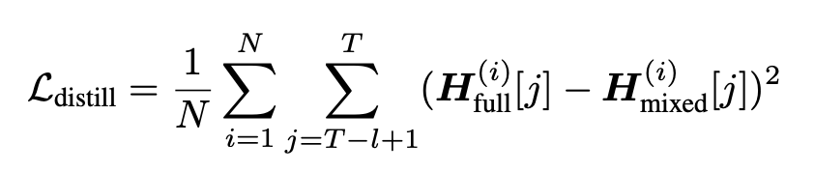
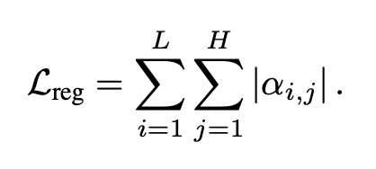
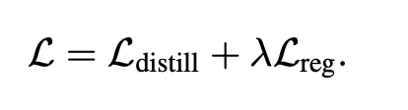
Loss Function
Compare hidden states of the full model vs the α-gated model on passkey data.
Distillation loss:
Regularization:
Final loss:
L₂ term makes α reproduce teacher behavior, L₁ term keeps only the necessary heads active.
Notes:
Lambda 0.05 hyperparameter in experiment
All other params in the model are frozen
In simple terms, we’re distilling the teacher’s full-context knowledge into a compact head mask only a few heads keep full memory

Slide 43
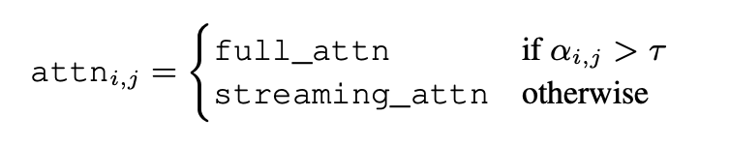
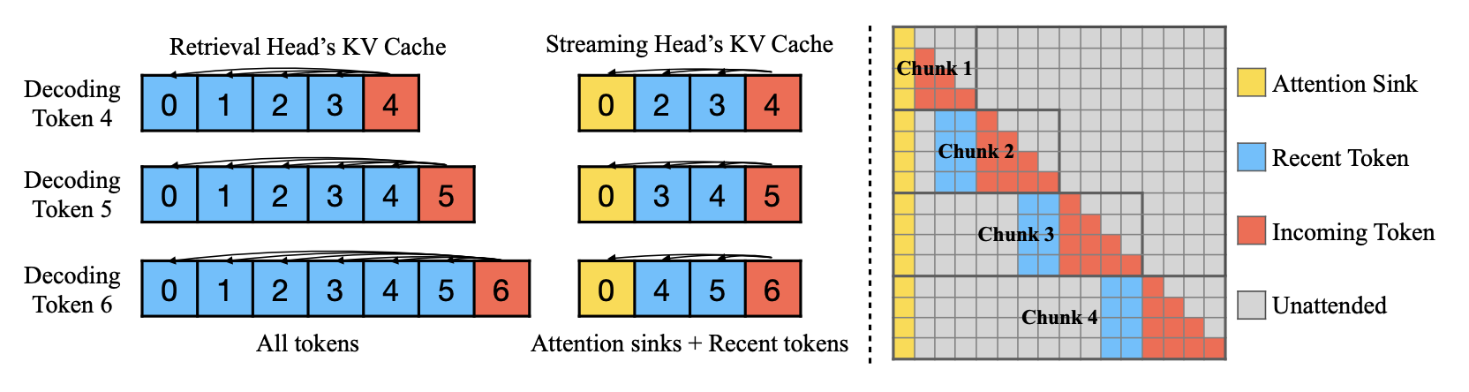
Deployment
Head Assignment:
Head Reordering:
Group retrieval and streaming heads contiguously in Q, K, V.
Enables faster slicing and decoding.
Dual KV-Caches:
Maintain two caches per layer:
Retrieval → store all tokens.
Streaming → store attention sinks + recent tokens.
Combine outputs during decoding.
Chunked Pre-filling:
Use FlashAttention-2 to fill caches chunk-by-chunk.
Prune old streaming KV after each chunk → lower memory (O(K)).

Slide 44
Dataset, Model, Baselines
Long-context Benchmark: LongBench, Needle-in-a-Haystack (NIAH)
Short-context Benchmark: MMLU, MBPP, MT-Bench
Models:
Short-context:
LLaMA-2-7B-32K-Instruct (MHA), LLaMA-3-[8B, 70B]-Instruct (GQA)
Long-Context:
LLaMA-2-7B-32K-Instruct (MHA)
LLaMA-3-8B-Instruct-Gradient-1048k (GQA )
Mistral-7B-v0.2-Instruct (GQA)
Baselines: H₂O, TOVA, StreamingLLM
Notes:
cover both retrieval-heavy long-context and standard short-context reasoning, across models from 7B to 70B parameters.

Slide 45
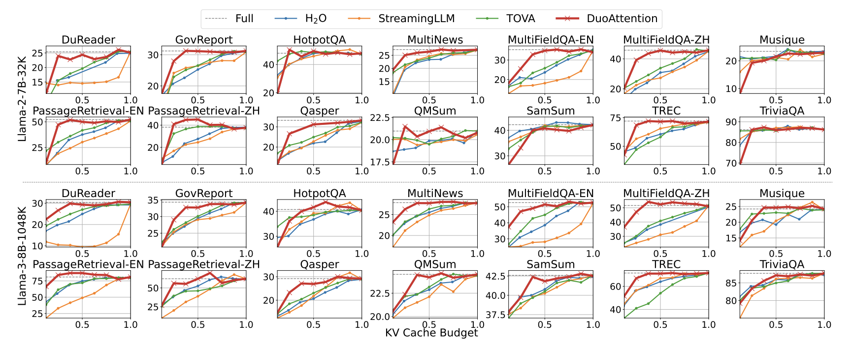
Result – Long Context (LongBench)
DuoAttention ≈ Full Attention at 50% KV cache
Consistent lead across retrieval & summarization tasks
Stable across models: Llama-2-7B & Llama-3-8B
Notes:
Across all 14 LongBench tasks, DuoAttention maintains near-full accuracy using only half the KV cache — outperforming prior compression methods

Slide 46
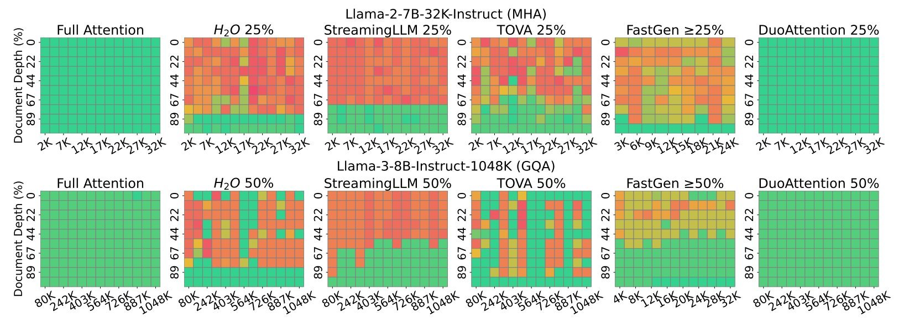
Result – Long Context (NIAH)
Near-perfect recall even at 25–50% cache
Uniform attention across document depth
Best retrieval consistency among all methods
Notes:
Even when the target token is buried deep in 100K+ context, DuoAttention consistently retrieves it — proof that it learns which heads matter for memory.

Slide 47
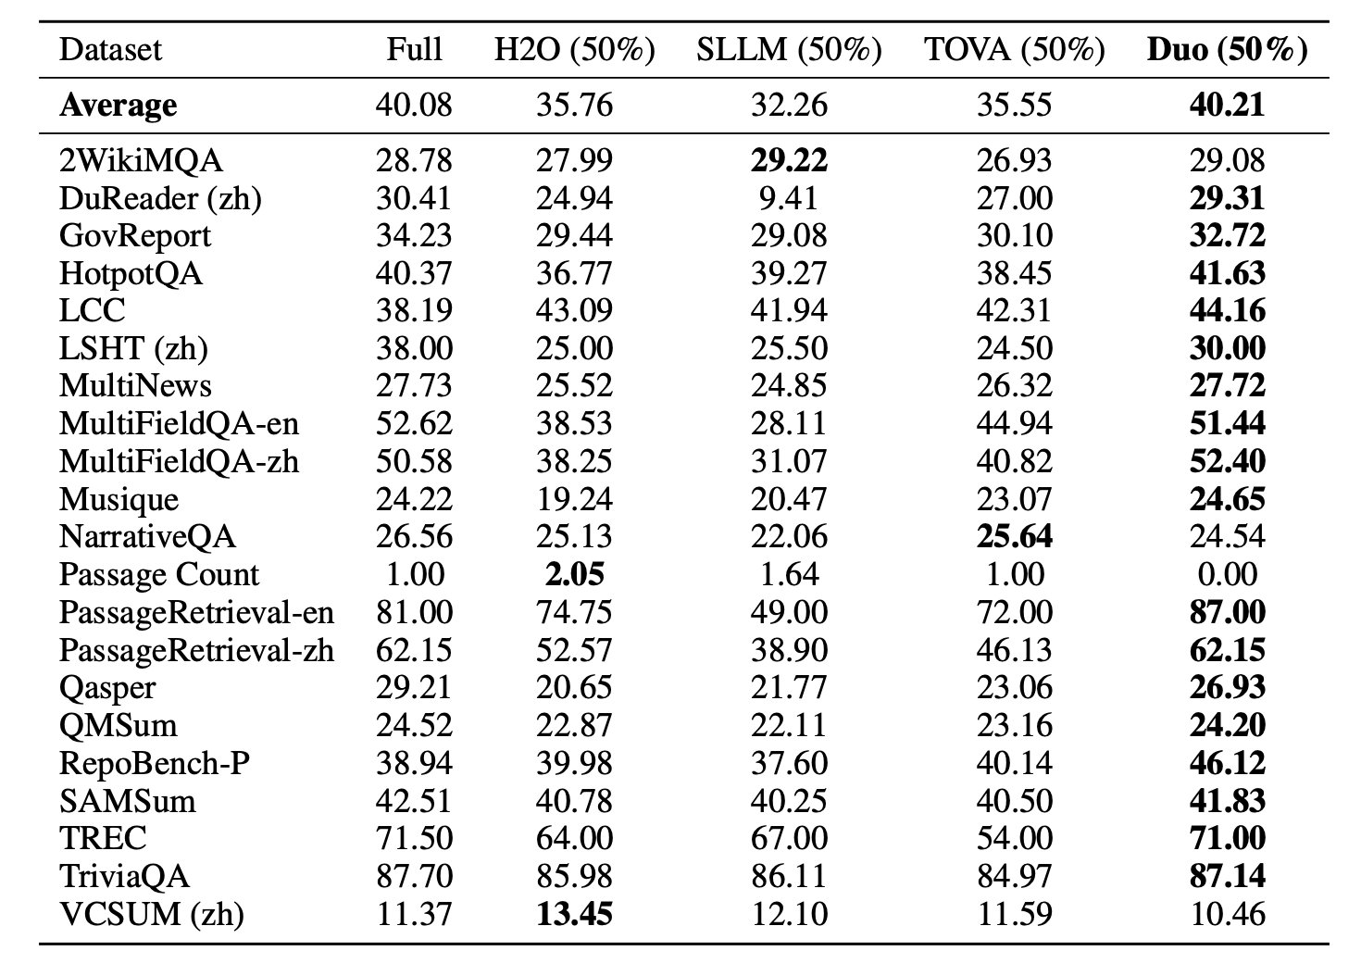
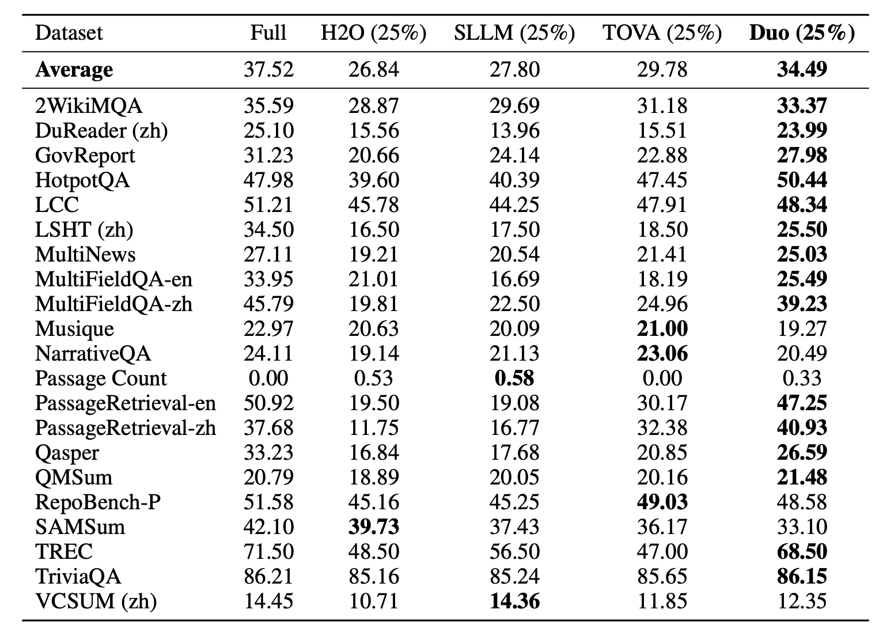
Quantitative Summary (Long Context Tables)
Llama-3-8B-Instruct-1048K
Llama-2-7B-Instruct-32K
Notes:
Highlights for left table (Llama-3-8B):
Average gain: DuoAttention (40.2%) > Full Attention (40.1%) → near-identical accuracy with half memory.
Top tasks: +5–10% improvement on MultiFieldQA and PassageRetrieval vs H₂O, TOVA.
High recall tasks preserved: TriviaQA 87.7% → 86.1% (minimal drop).
Highlights for right table (Llama-2-7B):
Average: DuoAttention (34.5%) > all baselines (next best TOVA 29.8%).
Across 12/17 tasks, DuoAttention gives highest or 2nd-highest score.
Numerically, DuoAttention provides the best overall accuracy-memory tradeoff — consistently topping or matching full attention with 2× less cache.
Matches or exceeds full attention with 50 % memory, showing best accuracy-efficiency trade-off

Slide 48
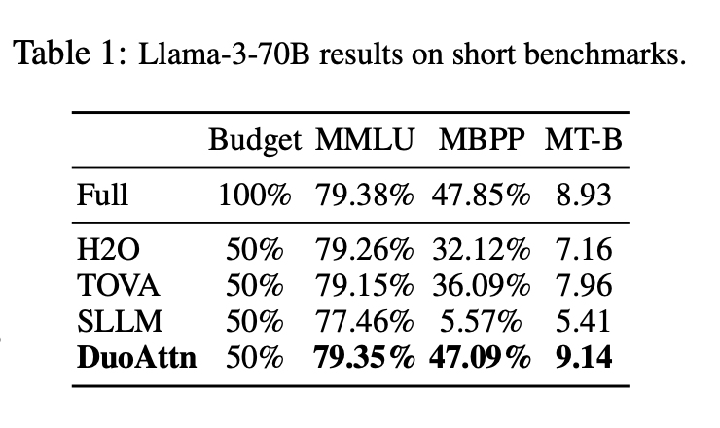
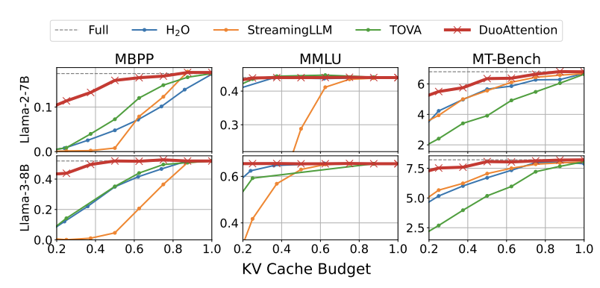
Result – Short Context
No drop in short tasks: MMLU ≈ 79 %, MBPP ≈ 47 %
Beats baselines on all short-context benchmarks
Generalizes beyond long-context setting

Slide 49
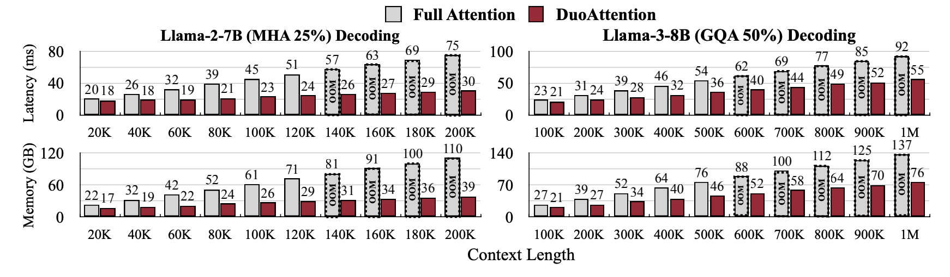
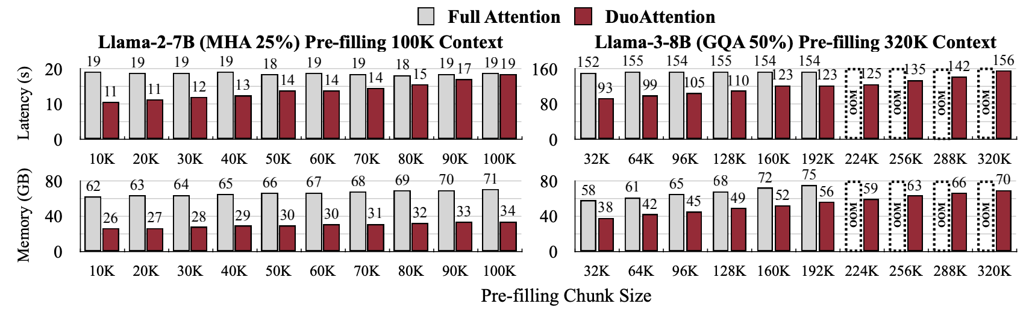
Efficiency Study
Decoding speedup:
2.18× (MHA), 1.50× (GQA).
Prefill speedup:
1.73× (MHA), 1.63× (GQA).
Memory reduction: 2.55 × (MHA) and 1.67 × (GQA).
Streaming head complexity:
Runtime: O(L²) → O(L·K);
Memory: O(L) → O(K)

Slide 50
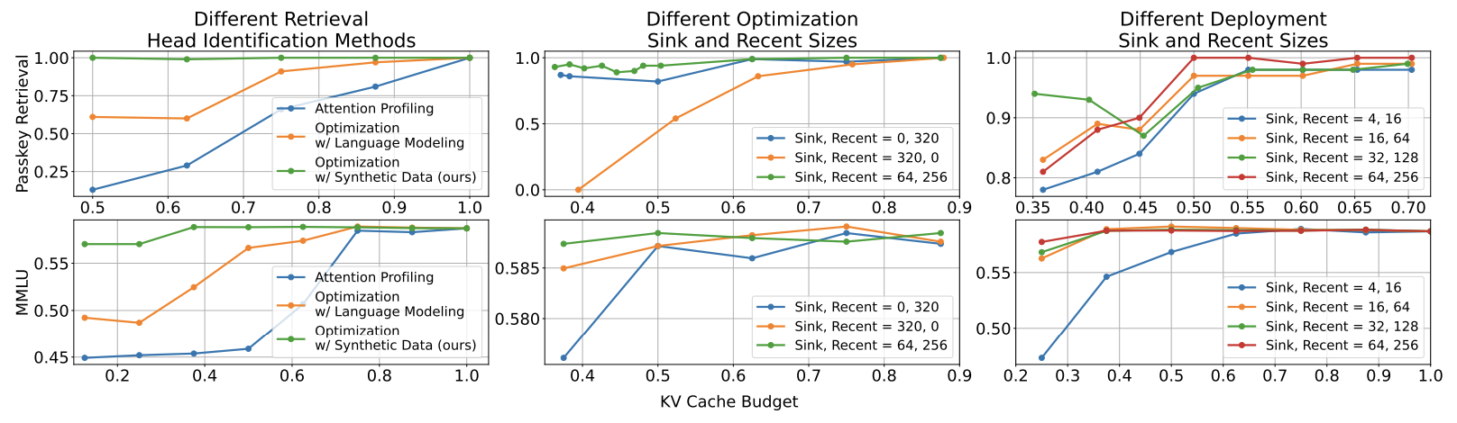
Ablation Study
Synthetic passkey optimization → best retrieval & reasoning.
Profiling / LM loss methods fail to capture true retrieval heads.
Moderate windows (Sink = 32–64, Recent = 128–256) ≈ full performance.
Too small windows sharply degrade retrieval accuracy.
Balanced cache (Sink = 64, Recent = 256) gives highest performance.
All-sink or all-recent setups reduce generalization.
Notes:
Topleft this trend :explains α learned from synthetic retrieval data isolates long-range heads effectively.
Middle: balanced KV cache keeps both global anchors and local continuity.
Topright: highlights real deployment trade-off shrinking cache too much loses long-range info.

Slide 51
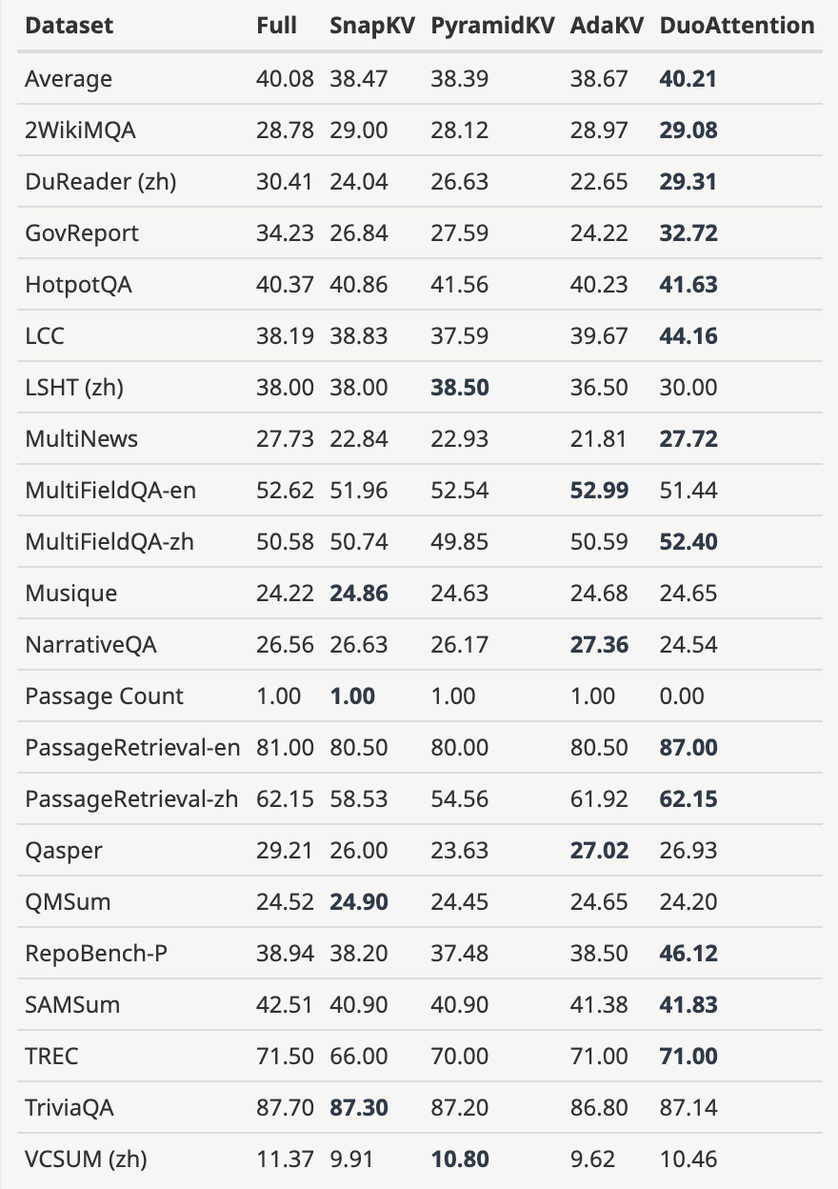
Baseline KV-Cache Comparison
Dataset: Longbench
KV-Cache optimization methods: DuoAttention, SnapKV, PyramidKV, AdaKV
Model: Llama-3-8B-Instruct-Gradient-1048k model
50% KV cache budget
DuoAttention → highest avg. accuracy (40.21 %)
Observation:
Snap, pyramid, adakv relies on heuristic token windows → query-position sensitive
Struggles with multi-turn or continuous generation
DuoAttention learns head importance directly → robust across scenarios
→ DuoAttention achieves broader generalization without handcrafted heuristics.
Notes:
Key Observations:
Best Accuracy Across Benchmarks: DuoAttention achieved the highest average score (40.21) among all methods. It consistently outperformed SnapKV, PyramidKV, and AdaKV across the majority of tasks.
Robustness to Query Positioning: Building upon the studies in Appendix Section 6 and Appendix Section 12, we observed that SnapKV-style methods (including PyramidKV and AdaKV) rely heavily on an observation window of tokens to identify important KV cache entries. These methods are sensitive to query positioning and struggle in scenarios involving continuous pre-filling or multi-round dialogue, where queries are not always located at the end of the context. DuoAttention does not depend on this heuristic, enabling superior performance in a broader range of applications.
Generality and Applicability: DuoAttention excels across various tasks and demonstrates resilience to real-world complexities like various query placement, continuous pre-filling, and multi-round dialogue, unlike other KV cache compression techniques.
DuoAttention focuses on head-level heterogeneity vs. layer/token-level.

Slide 52
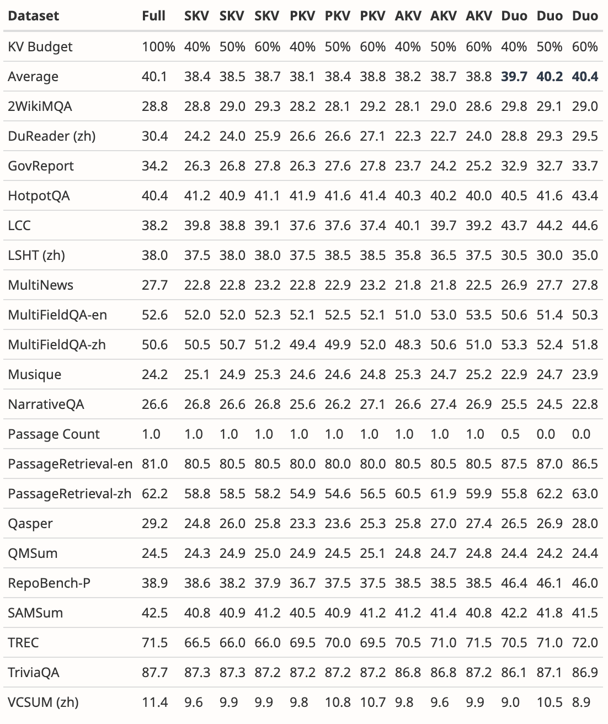
Evaluated under 40 %, 50 %, 60 % KV budgets
DuoAttention outperforms all baselines at every budget
Accuracy remains stable as cache shrinks
Average accuracy gain ≈ +4 – 5 % vs SnapKV / AdaKV across LongBench tasks.
Notes:
At half the KV memory, DuoAttention preserves full-attention-level accuracy.
Unlike SnapKV, performance doesn’t collapse when the cache budget drops to 40 %.
This table confirms scalability across multiple budgets and datasets.

Slide 53
Main Takeaway
My Comments
DuoAttention reduces KV cache and speeds up inference with minimal accuracy loss (limited to streaming heads).
Reveals head-level specialization and differing retrieval roles in LLMs.
A global τ threshold may overlook layer-specific importance patterns.
Future direction: test on multimodal or dynamic tasks (image / video).
DuoAttention bridges efficiency and interpretability, but scaling to multimodal and adaptive retrieval remains open.
Notes:
Mixed-modality KV-cache likely exhibits non-uniform retrieval dynamics.

Slide 54
Discussion Questions
DuoAttention (Redesigned)
Do specific heads specialize in particular reasoning or retrieval tasks??
Do heads generalize across tasks or domains
Could head classification (gating) help interpret model behavior or guide pruning?
OmniKV (Dynamic)
Given an LLM, find 𝑘 filter layers that give the lowest distortion in attn-score
More Information Retrieval (IR) methods other than full attention in filter layers
In General
Beyond layer- or head-wise eviction, what other dimensions can we slice?
More paradigms in addition to Static, Dynamic and Redesigned?
Notes:
time, modality, semantic importance

